Slide 1

AgriIntelligence – An End-to-End Crop, Weather & Market Analytics Platform
DATA SCIENCE - (24AD3107)
Project Review-1
1 8/09/2026 & 8:00 AM
 | Under the Guidance of Ms. Bonagani Prathusha Assistant Professor, Department of Computer Science and Engineering, KLH CSE Bowrampet Campus
Team Members D Kamal - 2420030290 V Chandra - 2420030291 G Khethana - 2420030461

Slide 2
Outline of Project Work
Focus
Introduction
Literature Survey
Challenges
Research Objectives
Conclusion & Future Work
References
Publications Details

Slide 3
Problem Statement
Agriculture is highly dependent on crop conditions, weather patterns, and market prices, but this information is often available in separate datasets and is difficult to analyze together. Farmers and agricultural stakeholders may struggle to identify suitable crop conditions, estimate expected yield, understand weather-related impacts, and track changing market prices.
AgriIntelligence aims to address this problem by developing an end-to-end data analytics platform that integrates crop, weather, and agricultural market data. The system performs data preprocessing, exploratory analysis, visualization, and machine-learning-based crop yield prediction to generate meaningful insights.
The platform helps users analyze historical agricultural data, predict crop yield, understand market price trends, and support data-driven agricultural decision-making through a simple interactive interface.
3

Slide 4
Objectives
Collect and integrate crop, weather, and agricultural market datasets into a single platform.
Clean and preprocess agricultural data by handling missing values, duplicates, inconsistent formats, and invalid records.
Analyze crop and weather patterns to identify factors that influence crop production and yield.
Develop a machine learning model to predict crop yield based on relevant agricultural and environmental factors.
Analyze market prices to understand commodity price variations and trends across markets.
Create interactive visualizations such as charts and graphs for easy interpretation of agricultural data.
Provide an easy-to-use dashboard that presents predictions, market insights, and analytical results in one place.
Support data-driven decision-making by converting agricultural data into meaningful and actionable insights.
4

Slide 5
Literature Survey
Authors | Title of the Paper | Methodology | Inferences | Limitation/Future work
Thomas van Klompenburg et al | Crop Yield Prediction Using Machine Learning: A Systematic Literature Review | ML models using weather, soil and crop data | Weather and soil factors are important for predicting crop yield | More diverse datasets and better models can improve predictions
D. Elavarasan et al. | Forecasting Yield by Integrating Agrarian Factors and Machine Learning Models | ML models combining agricultural and climate factors | Combining multiple agricultural factors improves yield forecasting | More environmental and regional factors can be included
K. R. Prasad et al. | Weather-Based Statistical and Neural Network Tools for Forecasting Rice Yields in Major Growing Districts of Karnataka | Weather data + statistical and ANN models | Weather information can be effectively used to forecast crop yield | Study is focused mainly on rice and specific districts
Payal Mahajan et al. | Forecasting Agricultural Commodity Prices Using Machine Learning Models | ML models using historical agricultural market prices | ML can identify patterns in commodity prices | Weather, production and other external factors can be integrated

Slide 6
Problem Gap Identification
Existing Approach | Problem | Our Project
Separate crop analysis | Crop information is analyzed independently | Integrates crop analytics in one platform
Manual yield estimation | Time-consuming and less data-driven | Uses Random Forest for yield prediction
Weather data analyzed separately | Difficult to relate weather with crop yield | Uses rainfall and temperature as prediction factors
Separate market analysis | Market trends are not connected with crop insights | Provides agricultural market analytics
Raw agricultural datasets | Difficult to interpret large datasets | Performs data preprocessing and visualization
Static reports and charts | Limited user interaction | Provides an interactive Streamlit dashboard
Single-purpose agricultural tools | Users need multiple systems for different analysis | Combines crop, weather, agricultural factors, yield prediction and market analytics
6

Slide 7
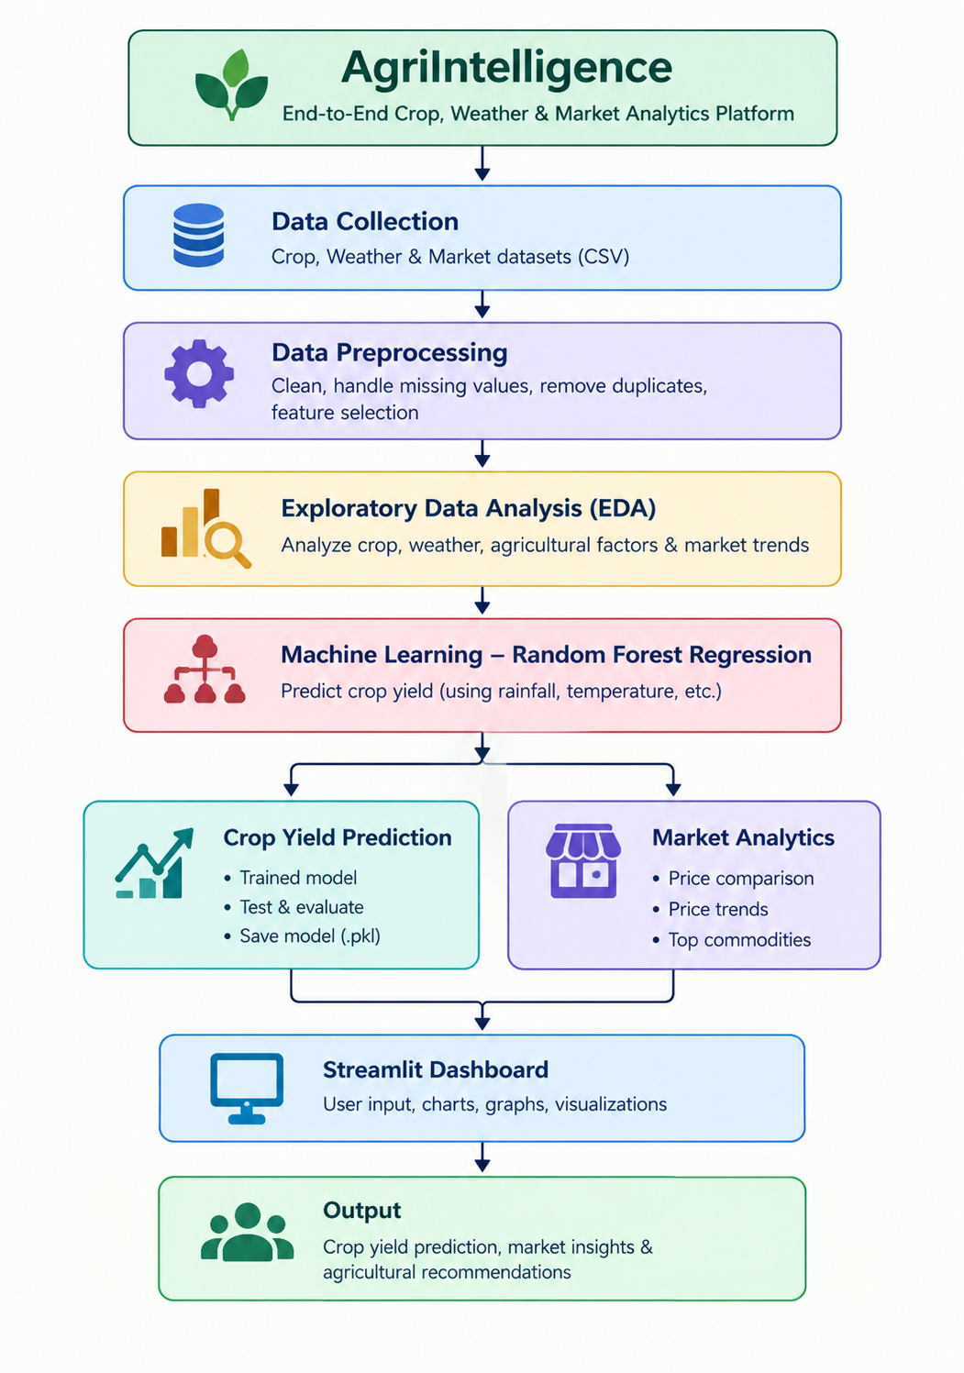
System Workflow
7

Slide 8
Technologies & Tools Used
Programming & Development
Python – Main programming language
VS Code – Development environment
Jupyter Notebook – Data analysis and experimentation
Data Processing & Visualization
Pandas – Data loading, cleaning and preprocessing
NumPy – Numerical data processing
Matplotlib – Data visualization
Seaborn – Statistical visualization
Machine Learning
Scikit-learn – Machine learning implementation
Random Forest Regression – Crop yield prediction
Joblib – Saving and loading the trained ML model
Application
Streamlit – Interactive web dashboard
Datasets
Crop Yield Dataset – Crop, country, year, rainfall, pesticides, temperature and yield
Agricultural Market Dataset – State, district, market, commodity, arrival date and price information
8

Slide 9
Innovation, Creativity, and Novelty
Integrated Agricultural Platform: Combines crop, weather, yield prediction, and market data in one system.
ML-Based Yield Prediction: Uses machine learning to estimate crop yield from agricultural and environmental factors.
Market Intelligence: Provides commodity price comparisons and market trends to understand price variations.
Interactive Dashboard: Presents predictions, graphs, and insights through a simple user-friendly interface.
Data-Driven Insights: Converts raw agricultural datasets into easy-to-understand visual information for better decision-making.
End-to-End Approach: Covers the complete process from data collection → preprocessing → analysis → prediction → visualization.
Novelty:
AgriIntelligence integrates multiple agricultural analytics capabilities into a single end-to-end platform instead of addressing crop prediction, weather analysis, and market analytics separately.
9

Slide 10
Feasibility and Project Plan
Feasibility
Technical: Uses Python, Pandas, Scikit-learn, Matplotlib/Seaborn and Streamlit, which are suitable for implementation.
Data: Uses publicly available crop and agricultural market datasets for analysis and model development.
Cost: Uses mainly open-source tools and datasets, so implementation cost is low. development
Time: The project can be completed within the academic project timeline through modular.
Practicality: The system provides crop-yield predictions, market analysis, and visual insights through a single dashboard.
Project Phase | Duration | Key Deliverable
Phase 1: Requirement Analysis & Data Collection | Weeks 1-2 | Finalized crop, weather and market datasets
Phase 2: Data Preprocessing & EDA | Weeks 3-4 | Cleaned datasets and exploratory analysis results
Phase 3: ML Model Development | Weeks 5-7 | Trained ML models for each prediction module
Phase 4: Market Analytics & Dashboard | Weeks 8-9 | Interactive dashboard with market insights and visualizations
Phase 5: Testing, Evaluation & Documentation | Weeks 10-12 | Validated results, final dashboard and project report
10

Slide 11
THANK YOU
11

